Slide 1


An Invitation to Collaborate and Succeed
Techcruit offers a unique opportunity to collaborate on innovative solutions. We are committed to helping your business succeed. We are excited to explore how our expertise can align with your goals.

Slide 2
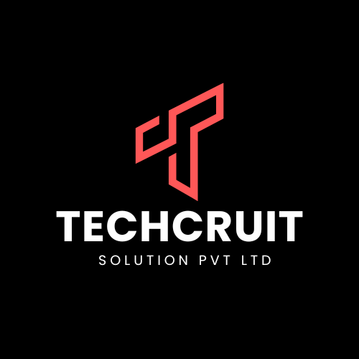
About Techcruit Solution
Techcruit Solution Pvt Ltd is a dynamic and client-centric IT & HR services company based in India. We specialize in delivering tailored solutions in IT Staffing, Payroll Management, HR Consulting, and Technology Services. With a strong focus on quality, compliance, and innovation, Techcruit empowers businesses by providing them with top-tier talent and seamless backend support.
Our team brings together industry expertise and process efficiency to cater to startups, SMEs, and large enterprises across sectors. Whether it's deploying agile tech teams, managing complex payroll operations, or delivering custom IT solutions, we are committed to being your trusted growth partner.

Slide 3
Leadership Team

Slide 4

Building Principles - The Value of Values
Our values drive our commitment to our clients and employees.
Respect: For the individual, both client and employee.
Integrity: Sincerity and honesty in all interactions.
Transparency: Easy access to information for all stakeholders.

Slide 5

Our Solutions
IT & Technical Staffing
Contractual & Permanent Hiring
Domain-Specific Resource Deployment
End-to-End Talent Acquisition Process
HR & Recruitment Process Outsourcing (RPO)
Dedicated Recruiters for Each Client
Technical Filtering & First-Round Interview Support
Walk-In Drives & Campus Hiring
Payroll & Compliance Management
Automated Salary Processing
PF, ESIC, TDS, PT Filing & Compliance
Employee Lifecycle Management

Slide 6
🎯 Focused Industry Domains
IT & Software
Healthcare
Financial Services
FMCG
Media & Entertainment
Engineering
Automotive
Education

Slide 7
🔑 Why Clients Choose Techcruit
✅ In-Depth Technical Understanding
✅ Quick Response Time & Dedicated Team
✅ Competitive Pricing with Quality Focus
✅ Transparent Processes & Regular Reporting
✅ Metrics-Driven Delivery & Review Mechanisms

Slide 8
Techcruit Process Methodology
Our methodology ensures quality and efficiency.
1
Dedicated Recruiters
2
Regular Reviews
3
Metrics Control

Slide 9
Dedicated Recruiters for client focus.
Technical Interviews by internal experts
Walk-in Coordination and active client collaboration
Regular Review Meetings and performance tracking
KPI-Based Metrics to ensure delivery quality

Slide 10



Techcruit – Value Additions
We offer a sound technical backing for candidate filtering.
2
Technical Interviews
Participation in first/second round.
Technical Filtering
1
Done at the consultancy level.
Walk-in Coordination
Actively involve/participate with the client.
3

Slide 11


Pricing
Our prices are very competitive. We provide high quality resources and value for money.
Competitive
High
Pricing
Quality
Value
Money

